Slide 1

“Crop Recommendation System Using Machine Learning And IOT”
By Prathamesh Mane (22206003)
Milind Chavan (22206007)
Sahil Shaikh (22206004)
Aryan Bane (22206009)
Under the Guidance of
Prof. Viki Patil

Slide 2
Outline
Introduction
Literature Survey of the Existing Systems
Limitations of the Existing Systems
Problem Statement
Proposed System Design
Description of Proposed System
Technologies Stack for Proposed System
Implementation
Conclusion
References

Slide 3
Introduction
Agriculture is the backbone of any country, and it has become the most significant growing sector all over the world because of increasing the population.
About 60% of our country’s population works in agriculture which contributes more to our country's GDP and employment.
The main challenge in the agriculture industry is to improve farming efficiency and quality to fulfill the speedily increasing demand for food.

Slide 4
Introduction
The Crop Recommendation system is an innovative solution that leverages the power of Machine Learning (ML) and Internet of Things (IoT) to optimize crop yields and improve agricultural productivity.
The system uses ML algorithms to analyze various parameters such as soil type, climate, temperature, and humidity to recommend the most suitable crops for a particular region.
The system provides farmers with personalized crop recommendations, reducing the risk of crop failure and increasing their overall profitability.
By leveraging ML and IoT, the system aims to increase crop yields, reduce waste, and promote sustainable agriculture practices.

Slide 5
Literature Survey
Sr. No | Title | Author Name | Description
1. | Crop Recommendation with IOT and ML (IEEE EXPLORE 2023) [1] | C. V. Neha Niharika; K. Mothish Kumar; K. Harika; V. Venkatesh; A. Yasmine Begum | The project includes an Arduino-based hardware kit that provides information on pH, temperature, humidity, and the likelihood of rain by integrating this data on a webpage with a machine learning backend that uses the Random Forest algorithm to estimate crop output.
2. | A Machine Learning-Driven Crop Recommendation System with IoT Integration (IEEE EXPLORE 2024) [2] | Al Amin Islam Ridoy; Md. Abu Ismail Siddique; Oishi Joyti | This paper proposes a system that utilizes several types of soil and environmental characteristics to determine the ideal crop for a particular land. Via Internet of Things (IoT) devices, environmental characteristics that include temperature and humidity, as well as soil parameter that is pH will be immediately retrieved from the land, enabling instantaneous data gathering. Using a variety of algorithms, the suggested approach Gaussian Naive Bayes which they got 99.55% validation accuracy, determines which crop would be best for cultivation.

Slide 6
Literature Survey
3. | Design of Crop Recommender System using Machine Learning and IoT (IEEE EXPLORE 2023) [3] | Josephine Selle Jeyanathan; B. Veerasamy; B. Medha; G.Tharun Venkata Sai; R.Bharath Kumar; Varsha Sahu | The proposed prototype considers soil characteristics, such as pH value, soil temperature, and soil moisture, as well as environmental factors, such as humidity Via Internet of Things (IoT) devices, as inputs to the machine learning algorithm such as Decision Trees (DT), Random Forest, SVM, XG Boost for precise decision-making.
4. | IoT-Enabled Crop Recommendation in Smart Agriculture Using Machine Learning (IEEE EXPLORE 2023) [4] | Gregory Davrazos; Theodor Panagiotakopoulos; Sotiris Kotsiantis; Achilles Kameas | In this literature review soil, environmental and weather parameters continously measured by IoT sensors. This paper applies a set of state-of-the-art machine learning models for crop recommendation using an open dataset for multi-class classification. Evaluation results show that Random Forest classifier gives 99.99% accuracy to predict suitable corp.

Slide 7
Literature Survey
5. | Machine Learning Based Optimal Crop Selection System In Smart Agriculture (IEEE EXPLORE 2023) [5] | Sita Rani ; AmitKumar Mishra ; | The various ML techniques used in the proposed model are decision tree, support vector machine (SVM), and K-nearest neighbor (KNN). In the authors proposed another ML-based model to estimate the crop's water requirement using adaptive neuro-fuzzy inference system (ANSIF) and partial least-square regression (PLSR) methods. This system can forecast the water requirement for a crop for one week.
6. | Crop Prediction Model Using Machine Learning Algorithm (IEEE EXPLORE 2023) [6] | Ersin Elbasi; Chamseddine Zaki Ahmet E. Topcu; Wiem Abdelbaki; Aymen 1. Zreíkat, Elda Cina; Ahmed Shdefat and Louai Saker; | Authors want to provide a reliable method for estimating future wheat harvests in one of India's Punjab provinces. For precise and timely wheat crop yield prediction, an KNN with DT hybrid Machine learning model is proposed. To further improve the model's performance, the researchers used a genetic algorithm to tune the KNN-two DT's most crucial hyper parameters: the size of its window and the number of neurons in its hidden layer.
Notes:
Literature Survey

Slide 8
Limitations of Existing Systems
Data Accuracy: Inaccurate or incomplete data from sensors can lead to incorrect recommendations.
Complexity: Requires technical expertise for system setup, maintenance, and interpretation of results.
Data Integration: Challenges in integrating diverse data sources and ensuring consistency.
Adaptability: Models may struggle to adapt to sudden changes in environmental conditions or unforeseen events.
Maintenance: Continuous calibration and maintenance of sensors and systems are needed for reliable performance.
Scalability: Scaling the system for larger farms or diverse crops may be challenging and resource-intensive.

Slide 9
Problem Statement
The goal is to develop a Crop Recommendation System that integrates Machine Learning (ML) algorithms and Internet of Things (IoT) technologies to provide farmers with precise recommendations for crop cultivation.
The system will use real-time and historical data to analyze and predict the most suitable crops to plant in a particular region, aiming to maximize yield, optimize resource use, and ensure sustainable farming practices.
Weather Forecasting
Crop Recommendation
Crop Recommendation System Interface
Our system aims at minimizing these problems and looks forward to easing the activities of the farmers

Slide 10
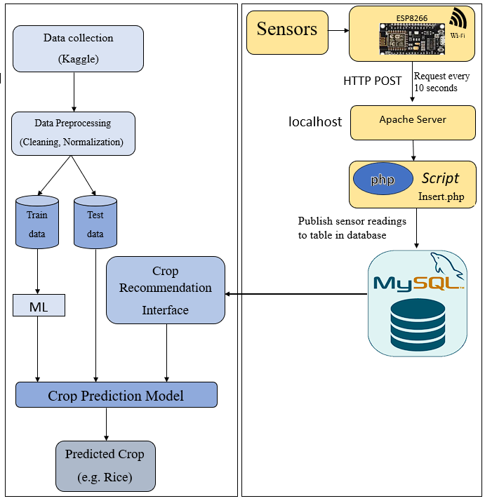
Proposed System Design
Fig.1

Slide 11
Description of Proposed System
1. Data Collection
Agricultural datasets are collected from Kaggle, containing parameters like nitrogen, phosphorus, potassium, temperature, humidity, pH, and rainfall.
2. Data Preprocessing
The data is cleaned and normalized to ensure consistency and improve model accuracy.
3. Machine Learning Model
The dataset is split into training and testing sets to build a model that predicts crop suitability.
4. Crop Recommendation Model
The trained model predicts the most suitable crop based on real-time environmental input.
5. User Interface
A user-friendly web application allows farmers to enter data and receive crop recommendations instantly.

Slide 12
Description of Proposed System
6. IoT Sensors
Sensors collect real-time data such as temperature, humidity, pH, and nutrient levels every 10 seconds.
7. ESP8266 Wi-Fi Module
This module sends sensor data to the server using HTTP POST requests via Wi-Fi.
8. Apache Server
Apache receives the sensor data and forwards it to the database for storage.
9. PHP Script (Insert.php)
A PHP script handles data insertion into the MySQL database in real time.
10. MySQL Database
The database stores current and historical sensor data for accurate crop predictions.

Slide 13



Technologies Stack for Proposed System
Python
PHP
HTML, CSS, JS
JavaScript
MySQL
Xampp

Slide 14
Hardware Setup
DHT11 Sensor:
Low-cost digital sensor for temperature and humidity measurement.
Easily interfaced with microcontrollers (Arduino, Raspberry Pi, etc.).
Humidity:
Measures water vapor present in the air.
Affects physical, chemical, and biological processes.
NodeMCU:
NodeMCU is an open-source IoT platform.-
Based on the ESP8266 Wi-Fi module.
Provides an edge in data transmission compared to other microcontroller boards like Arduino and Raspberry Pi.

Slide 15
Dataset
Crop Recommendation
Features:
Nitrogen
Potassium
Phosphorous
Humidity
Temperatures
Ph
Rainfall
https://www.kaggle.com/datasets/atharvaingle/crop-recommendation-dataset

Slide 16
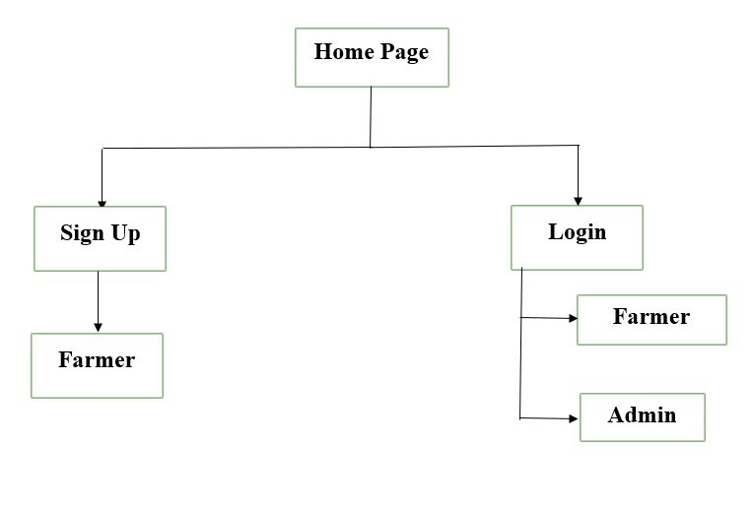
Home Page

Slide 17
Farmer Module
Farmer
Crop Recommendation
Profile
Weather forecasting

Slide 18
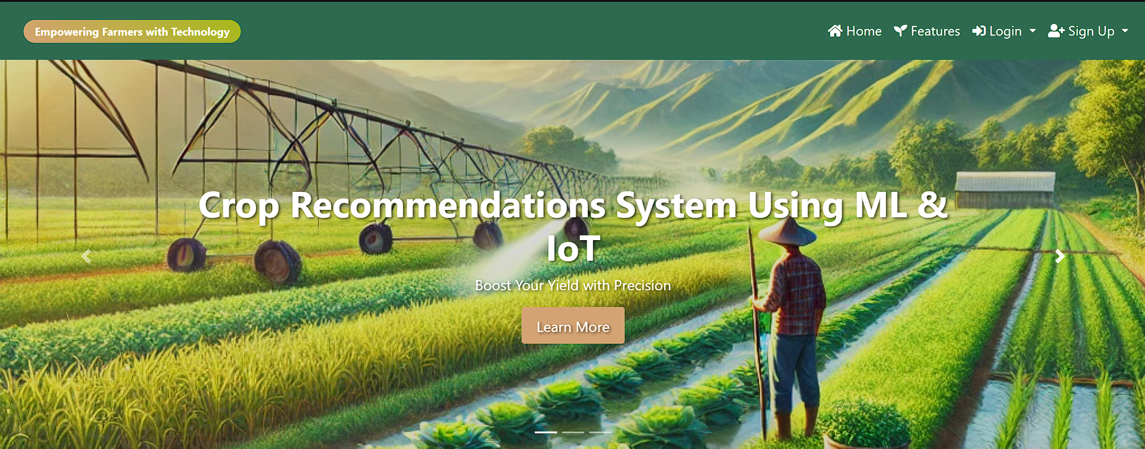
Implementation

Slide 19
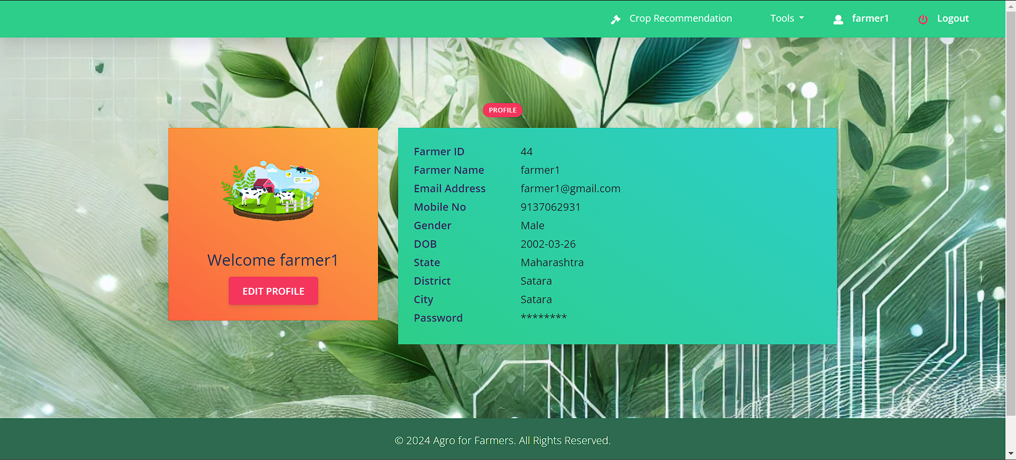
Implementation

Slide 20
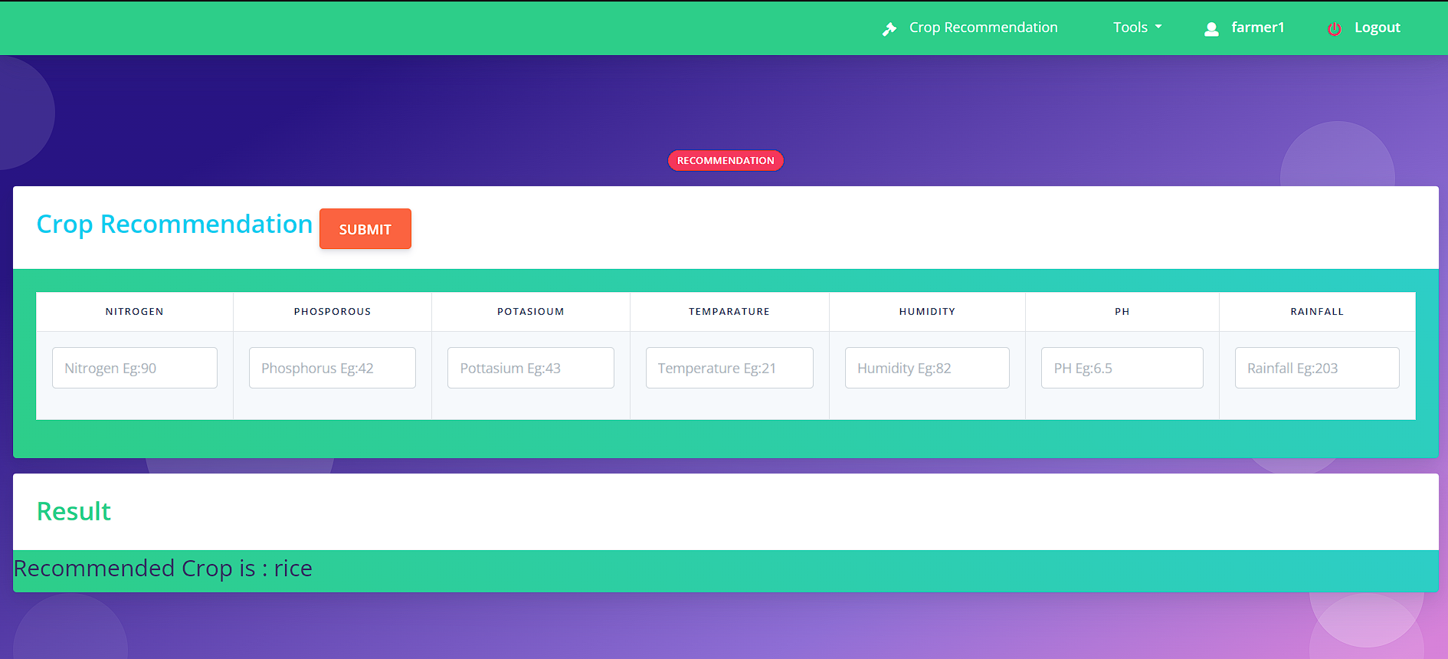

Slide 21
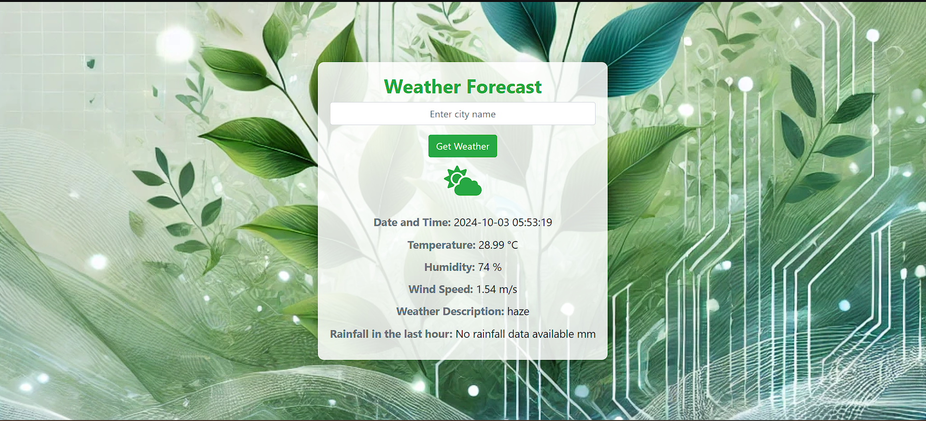
Implementation

Slide 22
Conclusion
In conclusion, the Crop Recommendation System can achieved significant success through a comprehensive technological approach. By integrating machine learning models with IoT devices, the system can effectively address the challenges faced by modern agriculture. The use of advanced data processing techniques, real-time monitoring, and customized recommendations will result in a highly accurate and efficient solution. This holistic approach will ensures that farmers receive precise, actionable insights tailored to their specific land conditions. The project’s success is evident in its ability to enhance crop productivity, optimize resource usage, and promote sustainable agricultural practices, delivering a comprehensive and transformative tool for the farming industry.

Slide 23
References
Journal Papers
[1] C. V. Neha Niharika, K. Mothish Kumar, K. Harika, V. Venkatesh and A. Y. Begum, "Crop Recommendation with IOT and ML," 2023 4th International Conference for Emerging Technology (INCET), Belgaum, India, 2023, pp. 1-5, doi: 10.1109/INCET57972.2023.10170561. keywords: {Temperature distribution;Rain;Crops;Production;Humidity;Soil;Predictive models;Machine learning;Random Forest;Arduino;Crop prediction.},
[2] A. A. Islam Ridoy, M. A. Ismail Siddique and O. Joyti, "A Machine Learning-Driven Crop Recommendation System with IoT Integration," 2024 6th International Conference on Electrical Engineering and Information & Communication Technology (ICEEICT), Dhaka, Bangladesh, 2024, pp. 812-817, doi: 10.1109/ICEEICT62016.2024.10534479. keywords: {Temperature distribution;Machine learning algorithms;Crops;Machine learning;Production;Soil;Internet of Things;IoT;Machine-Learning;Accuracy;Website;Crop Recommendation},
[3] J. S. Jeyanathan, B. Veerasamy, B. Medha, G. T. V. Sai, R. B. Kumar and V. Sahu, "Design of Crop Recommender System using Machine Learning and IoT," 2023 7th International Conference on Trends in Electronics and Informatics (ICOEI), Tirunelveli, India, 2023, pp. 1127-1132, doi: 10.1109/ICOEI56765.2023.10125963. keywords: {Temperature sensors;Temperature;Soil moisture;Crops;Prototypes;Humidity;Soil;crop recommendation system;STM32;ESP8266;pH values;annual rainfall;Humidity;Temperature;Soil moisture;Proteus},
[4] Davrazos, Gregory & Panagiotakopoulos, Theodor & Kotsiantis, Sotiris & Kameas, Achilles. (2023). IoT-Enabled Crop Recommendation in Smart Agriculture Using Machine Learning. 1-4. 10.1109/IISA59645.2023.10345924.
Useful Links
[5] https://www.kaggle.com/datasets/atharvaingle/crop-recommendation-dataset

Slide 24
Thank You

